Slide 1
Biblioteek- en Inligtingsdiens  Library and Information Service
Making important decisions about publishing your research
Lucia Schoombee, Naomi Visser, Daléne Pieterse
22 May 2013

Slide 2
Programme
08:30 Welcome and introduction 08:40 Session 1: Reaffirms the reasons for publishing; the principles that regulate academic publishing; factors to keep in mind when selecting a journal in which to publish 10:00 Tea break 10:20 Session 2: Journal metrics, Open Access publishing and archiving your articles 11:40 Comfort break 11:50 Session 3: The South African research outputs accreditation system 12:50 CLOSING

Slide 3
Meet the presenters
Naomi Visser is a faculty librarian for Arts and Social Sciences and is also responsible for the Library’s marketing portfolio (E-mail: nrv@sun.ac.za)
Daléne Pieterse is positioned in the Division for Research Development where she is primarily responsible for research information (E-mail: (mver@sun.ac.za)
Lucia Schoombee is head of the Research Commons and responsible for the communication portfolio of the Library (E-mail: lcs1@sun.ac.za)

Slide 4
Why this topic?
Complex environment. New journals have been established and we now have a wider range of outlets that serve as vehicles for our research.
Filling a gap. Workshops on academic writing/authorship, always allude to the importance of choosing the “right” journal, but often don’t provide guidance on how to go about it.
Strategic importance. Where you publish will affect your success as an author and ultimately affect your career.

Slide 5
So what?
Making the “right” choice about where you publish can potentially
Increase readership
Increase citations
Diminishing publication lag
Determines government subsidy
It may play a role in performance evaluation
Notes:
Increase readership It is important to publish in a journal that is widely distributed. This increases the potential of being read.
Increase citations
The more people who read your article, the better your chances will be for being cited. Citation is considered as endorsement of your research.
Diminishing publication lag
Making the “right” choice about where to publish will prevent unnecessary time lag caused by rejection of your article and having to re-write it according to the requirements of another journal
Determines government subsidy
If you don’t publish in a DHET approved journal, you will forfeit government subsidy and the University’s incentive for publishing
Performance evaluation
In some cases, the ranking of journals in which you publish, may influence your performance evaluation

Slide 6
Outcomes
IN SHORT:
This workshop is aimed at providing you with the necessary skills and knowledge to make informed decisions about where to publish your research.
By the end of the workshop, you should have a good idea where to send your work - Whether, if you study birds, it should be “International Bulletin of Ornithology” or “Birdwatcher’s Newsletter”!
Notes:
In short
This workshop is aimed at providing you with the necessary skills and knowledge to make informed decisions about where to publish your research.
By the end of the workshop, you should have a good idea where to send your work - Whether, if you study birds, it should be “International Bulletin of Ornithology” or “Birdwatcher’s Newsletter”!
More specifically
Ability to make informed decisions about where to publish research by considering the difference between traditional and open access publishing and consulting accredited lists, impact factor and other indicators.
Employ ‘good practice’ in terms of standardised author name and preservation of research output.
Ability to recognise the features of a good journal Understand DHET’s Research Outputs Accreditation System including lists of accredited journals: ISI Citation Indexes, IBSS, DoE list of approved journals Use journal metrics to determine the relative impact of journals (Impact factor and Journal Citation Reports (JCR), SJR, SNIP, Scopus Journal Analyser Understand the benefits of Open Access, where to find Open Access journals, and where to find funding for OA publishing Making your research available in the University’s Institutional Repository (SUNScholar)

Slide 7
Note the parameters
It’s only about journals
For beginners
The focus is on journal attributes, indicators, and other aspects related to selecting a suitable journal, and NOT on academic writing and authorship
Presenters expertise – we know the tools and the environment
Notes:
It’s only about journals
This workshop does not cover books, proceedings or any other publication format. The focus is wholly on journals
For beginners
The workshop is aimed at novices in publishing and emerging researchers
Focus is NOT on academic writing and authorship The focus is on journal attributes, indicators, and other aspects related to selecting a suitable journal
Presenters expertise The presenters are not necessarily experienced authors, but instead are knowledgeable about the tools used to evaluate journals and the about the publishing environment in general

Slide 8
Contents of Session 1
Why publish
Concepts and principles related to scientific literature
Peer review system
Finding journals in a subject field
Attributes of a “good” journal
Match article type to journal type
Author guidelines
General considerations

Slide 9
Why publish
Advancement of human knowledge
Career advancement
Money?
“Students write their degrees. Academics write their careers… Writing is a currency in academia.”
Notes:
There are a number of reasons why authors want to publish and for many there are more than one reason. Some reasons are predictably more altruistic than others, but ultimately it boils down to two reasons:
Advancement of human knowledge; and
Career advancement
The main reason for publishing should be to tell others about the research.
Submitting for publication can provide useful peer review of one’s research, and the publication of a research article can lead to networking with individuals and groups with similar research interests. Other researchers can also use your research as the foundation on which to build their future work.
Publication in a peer-reviewed journal can benefit your career, as the allocation of grants, promotions, and other job opportunities usually rely on your ability to prove the number and quality of your research output.
In some cases, publication can also lead to money in the author’s pocket. (e.g. LitNet Akademies)

Slide 10
Principles related to scientific
literature
General principles
Originality
Describe methods and resources (allow replication)
Integrity with relation to data
Thorough statistical analysis
All relevant literature must be cited
Indicate “lead” author
Include only authors who have contributed directly at intellectual/conceptual level
Clearly specify speculative deductions and postulations and keep to minimum
Acknowledge funding, disclose affiliation of authors
“Publication date” and “date of submission” included in published version
Post publication detection of errors retracted in print of same journal
One full record preferred over a series of scattered short publications
Notes:
It is important to understand the concept of scientific literature and the principles supporting it. How does it differ from popular literature? Professor Wieland Gevers lists “a set of principles which regulate the publishing of research findings or ideas”.
The reported findings must be original, in the sense that they are the first report of such findings.
Reports must contain, or permit reference to, sufficient detail of the methods and materials used in the study to permit replication in the hands of other scientists/scholars.
Integrity of reporting requires that no inconsistent data are omitted or fabricated data presented, and that no plagiarism of work/text previously published by others is committed.
The statistical treatment of data must be thorough and the conclusions drawn therefrom reasonable.
The existing relevant literature must be appropriately and fairly cited. Ensure that reference is made to the first-published report of a finding rather than a later elaboration.
Authorship must conform to the notions of responsibility and credit for the work as a whole, listing only persons who have contributed directly to the production of the work at an intellectual/conceptual level.
Speculative deductions and postulations must be clearly specified and kept to a minimum.
Acknowledgement of funding sources and declaration of possible conflicts of interest must be complete, in an acknowledgement section.
Author affiliations must be provided which reflect both the period of the study and the present situation.
Priority is accorded from the date of acceptance of the publication of an article (which should be indicated in the final article), not from its date of receipt as a submission, i.e. the peer review must have already taken place. Both dates are, however, usually given in the published version.
Post-publication detection of errors and falsifications must always be corrected or retracted in print in the same journal
Studies addressing a particular question should not be broken up into a series of scattered short publications but preferably be presented once as a full record of the work and its results.

Slide 11
Peer review system
The integrity of scientific literature is protected by:
Author
Editor
Peer review
Notes:
Authors/researchers should ensure that they adhere to the principles as stipulated on the previous slide.
Through “responsible and fair editorial oversight” and an accessible editorial policy, editors should ensure that “only excellent articles are accepted, and that most of them are greatly improved after submission by rigorous, independent, multiple peer review”. (Gevers, 2013: 7).
Peer reviewers must carefully read and evaluate a submitted article and:
scrutinise the methods and results in terms of consistency, interpretability and likely reproducibility;
identify gaps that could or should be filled to enhance the interpretability and strength of the findings;
suggest how the paper can be improved in terms of style, length and focus;
assess the proper citation and referencing of previous studies (as outlined above in the “principles” section), including the critical issue of the originality of the work;
contest conclusions not justified by the results presented; and
“place” the work in the existing matrix of knowledge in the relevant area or field.

Slide 12
Finding journals in which to publish
Choose the journal at the very beginning
Different journals have different stylistic specifications and mandates
You may not submit your article to more than one academic journal at a time
If your article is rejected by one journal, you can consider submitting it to a second
Notes:
It is important to choose which journal to send your work to at the very beginning of the writing process. It is not a case of writing an article and then looking for a journal which will possibly publish it.
Different journals have different stylistic specifications which need to be strictly adhered to. Specifications are found in the journal’s author guidelines, which will be addressed later. Each journal has a specific mandate and articles are frequently rejected because they do not fit the aims and scope of a journal.
Keep in mind that you may not submit your article to more than one academic journal at a time.
If your article is rejected by one journal, you can consider submitting it to a second, but only after you modify your paper to fit that journal’s specifications.
Experienced scientists will likely have a journal or two in mind at the outset; however, if you are an inexperienced author, start by making a shortlist of journals within your subject field.

Slide 13
Create a shortlist
Subject guides by faculty librarians
ISI Journal Citation Reports
SciVal Experts
Browse the A-Z list of e-journals
Browse the library’s journal shelves
Ask your supervisor
Analyse your own citations
Notes:
There are a number of ways to find journals in a specific subject field:
Faculty librarians compile subject guides which often offer a list of journals related to the subject field concerned Find it: Library webpage > My Library > Subject guides
The ISI Journal Citation Reports categorise journals by subject Find it: Library webpage > Search > E-databases > Journal citation reports
SciVal Experts provides a list of journals where the most publications of a particular unit have appeared. The list is ordered with the journals that have the most publications included at the top. Find it: Library webpage > Quick links > Research Performance Management Tools > SciVal Experts > Select a Department > Click on Journals.
Browse the A-Z list of electronic journals Find it: Library webpage > Search > E-journals > Subjects
Browse the Library’s journal shelves Look up the call number of a journal that might be suitable and then look on the shelves around it for other journals with the same subject.
Ask your supervisor or mentor for a recommendation, but only if he or she publishes regularly and in a variety of journals.
Analyse the citations in your own research. Where were the articles you cited published? This can help you find journals that publish work on your topic and from your angle.

Slide 14
Evaluate your shortlist
Accreditation
Impact factor
Other factors to consider
Notes:
The next step is to evaluate the journals on your shortlist. Never send your article to a journal that you have not read or closely examined.
Two possible ways of evaluating a journal, is to check the journal against the lists of accredited journals that are available on the website of the Division for Research Development at Stellenbosch University (discussed in Session 3 by Dalene Pieterse) and to consider the impact factor of a journal (discussed in Section 2 by Lucia Schoombee). You will also find a link to the list of accredited journals on the Library’s Libguide on Bibliometrics and citation analysis.
Accreditation
Journals have to meet the following criteria to be eligible for inclusion in the lists of approved journals:
The purpose of the journal must be to disseminate research results and the content must support high-level learning, teaching and research in the relevant subject area.
Articles accepted for publication in the journal must be peer reviewed, i.e. evaluated by a panel of professionals with credentials in the article's field of study to ensure that the article meet the standards of their specialty.
The majority of contributions to the journal must be beyond a single institution.
The journal must have an International Standard Serial Number (ISSN).
The journal must be published regularly.
The journal must have an editorial board that includes members beyond a single institution and is reflective of expertise in the relevant subject area.
The journal must be distributed beyond a single institution.

Slide 15
Additional factors to keep in mind when choosing a journal
Reputation – of the journal and the publisher
Scope and focus of the journal
Turnaround time / publication lag
Included in prominent indexes
Longevity
Editorial standards / Journal information
Acceptance rate
Cost
Rights for authors
Type of publication
Notes:
Reputation – of the journal and the publisher
The reputation of the publisher, journal, editor and editorial board can give an indication of the quality of the journal.
Scope and focus of the journal
It is important that your article reaches the readers who can most benefit from it and who can most benefit you. The scope and aim of the journal will give an indication of who the journal’s readers are, e.g. national or international, limited to a select area of research or with a multidisciplinary focus. Your article should also suit the style of the journal.
Turnaround time / publication lag
What is the length of the review process? Average length of time from submission to acceptance or rejection; from acceptance to publication? Frequency of publication?
Included in prominent indexes
Are articles from the journal indexed in journal databases relevant to your field, or in citation databases such as Scopus or Web of Science?
Longevity
The number of years the journal has been around can be an indication of its stability and its interest to academia.
Editorial standards / Journal information
The competence of a journal’s editorial office can hugely influence the success or failure of an article. Make sure that the “Instructions to Authors” are easily accessible and that they set out clearly what is expected from authors. Does the journal come out on time or is it often two or three years behind? Is the journal carefully produced with a professional appearance, or does it have many typing errors, poor paper quality and other signs of neglect? Does the journal accept electronic submissions? This simplifies the submission process, allows swift management of manuscripts and makes it possible for authors to track the position of their manuscripts in the review process.
Acceptance rate
The acceptance rate gives an indication of how competitive a journal is. Journals with a low acceptance rate are considered to be amongst the most prestigious in their field, the assumption being that only the very best articles are selected.
Cost
Be aware that some journals charge either a submission fee, an acceptance fee, page fees or fees for use of colour images or other special media formats.
Rights for authors
Check the journal website or their copyright form for information on author rights. Are you allowed to re-use the article after publication or to submit the post-print to the University’s research repository?
Type of publication
Some journals only accept only certain types of articles for publication. The next section discusses the different types of journals and types of articles.

Slide 16
Match article type to
type of journal
Types of journals
Traditional academic research journal
Letters journal
Review journal
Professional journal / magazine
Types of journal manuscripts
Original article
Rapid Communication
Review Article
Case Study
Theoretical article
Notes:
It is important to match the type of article to the type of journal. Journals usually indicate the type of articles they accept in the “Instructions to Authors” section of the journal. Some journals publish only reviews. These journals usually have titles starting with “Advances in…”, or “Progress in.. “ or have the word “reviews” or similar distinguishing words in the title. Some journals publish a combination of different types of articles.
Types of journals:
Traditional academic research journal – Main venue for primary research, rigorously peer-reviewed.
Letters journal – Rapid communication of interim work, peer-reviewed, a good way to get very new and on-going research initially published.
Review journal – Covers current trends, usually peer-reviewed, contains some commissioned material.
Professional journal / magazine – Mainly review and how-to articles, lots of commissioned material, heavily edited but not necessarily peer-reviewed.
From: http://www.slideshare.net/MarisaPaco/publishing-scientific-research
Types of journal manuscripts
Original article / Research article
This is the most common type of journal manuscript. It may be called an Original Article, Research Article, Empirical Article or just Article, depending on the journal. The Research Article reports on the results of original research, but will also include a bibliography of other literature reviewed. These articles will have the following elements: an introduction, description of the research design, discussion of the data, methods and results, and bibliography.
Rapid Communications
These papers communicate findings that editors believe will be interesting to many researchers, and that will likely stimulate further research in the field. Rapid Communications usually receive prioritized handling by the editors and are published soon after submission to the journal. This format is therefore useful for scientists with results that are time sensitive (for example, those in highly competitive or quickly-changing disciplines). This format often has strict length limits, so some experimental details may not be published until the authors write a full Original Research manuscript.
Many journals also refer to this type of manuscript as a Letter.
Example: Journal of Economic Entomology
Review Articles:
Review Articles provide a comprehensive summary of research on a certain topic, and a critical perspective on the state of the field and where it is heading. They are often written by leaders in a particular discipline after invitation from the editors of a journal. Reviews are often widely read (for example, by researchers looking for a full introduction to a field) and highly cited. Reviews commonly cite approximately 100 primary research articles.
Case Studies
These articles report specific instances of interesting phenomena. A goal of case studies is to make other researchers aware of the possibility that a specific phenomenon might occur. This type of study is often used in medicine to report the occurrence of previously unknown or emerging pathologies.
Theoretical articles
These articles do not contain original empirical research, but use existing research to present a new theory or to analyse or criticize existing theories.

Slide 17
Author guidelines
Notes:
The author guidelines of most journals can be found on the journal website. (Do a Google search)
Read the guidelines attentively and prepare your manuscript exactly in accordance with the guidelines. Note the word count, layout of the text and illustrations, format of references and in-text citations, etc. (The wrong reference system is often a give-away that the article was rejected elsewhere.)
Check if the journal is invitation only, because some journals will only accept invited articles.
Avoid journals with no clear submission and reviewing process.
Author guidelines will also include information on the types of articles accepted, editorial team contacts, specifications for graphics, acceptable language and article length.

Slide 18
Exercise 1
Find the author guidelines for Muziki: Journal of Music Research in Africa and indicate which reference system is used by this journal.

Slide 19
General considerations
Listing of authors
Only individuals who made a substantial intellectual contribution may be listed as co-authors.
Others are acknowledged.
Co-authors are listed in order of contribution, from most to least.
Create a unique author name to ensure that you are able to track citations to your research and that your research can be found continuously
e.g. Researcher ID http://www.researcherid.com/
Early rejection is often due to poor preparation
Failure to meet submission requirements
Incomplete coverage of the literature
Poor language/grammar use
An article may only be submitted to one journal at a time!
Notes:
My last slide deals with some general considerations that new authors should keep in mind.

Slide 20
Contents of Session 2
Journal metrics
What is it?
Four indicators: (1) Impact factor (2) Scimago Journal Rank (3) Source-normalised Impact per Paper, (4) Google Analytics
Open Access
What is it?
What are the benefits?
Where to find journals
Funding
Archiving your articles
SUNScholar

Slide 21
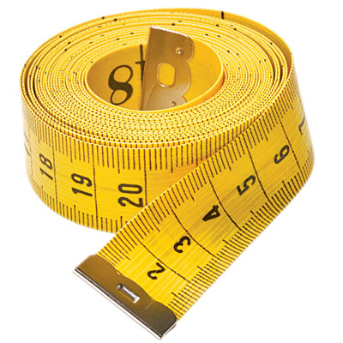
Journal metrics
Journal metrics use citation analysis to
measure the performance of scholarly journals
provide rankings of journals
A citation to a paper is a form of endorsement and ultimately expresses significance
Various metrics use different methods and offer different perspectives
Notes:
Besides considering the various general attributes which indicate whether a journal is good, there are also metric (or “indicators”) which have been developed for the same purpose.
Journal metrics measure the performance and/or impact of scholarly journals.
Each metric has its own particular features, but in general, they all aim to provide rankings and insight into journal performance based on citation analysis. They start from the basic premise that a citation to a paper is a form of endorsement, and the most basic analysis can be done by simply counting the number of citations that a particular paper attracts: more citations to a specific paper means that more people consider that paper to be important. Citations to journals (via the papers they publish) can also be counted, thus indicating how important a particular journal is to its community, and in comparison to other journals.
Different journal metrics use different methodologies and data sources, thus offering different perspectives on the scholarly publishing landscape, and bibliometricians use different metrics depending on what features they wish to study.

Slide 22
Data sources for metrics
Three main sources exist for citation analysis:
Thomson Reuters Web of Science
Elsevier’s Scopus
Google Scholar
Notes:
Three main sources exist for citation analysis:
Thomson Reuters’ Web of Science
Web of Science, established in 1960, is an online citation index provided by Thomson Reuters (previously ISI)
Covers more than 13,000 journals and dates back to 1900
Only approx. 3,000 journals in Social Science and Humanities
Elsevier’s Scopus
Scopus was established in 2004 with the aim of being the most comprehensive STM and Social Science abstract and citation database
Covers 19,400 journals and dates back to 1996
Much larger coverage of Social Sciences and Humanities
Google Scholar
Google Scholar was established in 2004.
List of sources is not provided but generally broader than Web of Science and Scopus
Good foreign coverage

Slide 23
Journal Impact factor
Developed by ISI (now Thompson Reuters) in 1960’s
Also known as JIF (Journal Impact Factor)
Most well-known journal metric, most notorious
Represents the impact a journal has in relation to other journals in a specific field
Measures the frequency with which the average article in a journal has been cited in
particular year
Despite criticism, widely used
Notes:
What is the Journal Impact Factor and why is it important to consider
The Impact Factor is the most well-known citation indicator, and also the most notorious.
The impact factor represents the impact a journal has in relation to other journals in a specific field.
The calculation of the impact of a journal is based on the average number of times the articles of a journal is cited in a two year period.
Although there is some argument about the usefulness of this metric in the Social Sciences and Humanities, it is frequently used across all subject fields.
It is important to consider the impact factor of a journal because those with higher impact factors generally have higher rejection rates.
It is probably wise to choose a journal that does not have a high impact factor for your first attempt at publishing. As you become more established, however, you should start to target higher impact factor journals.
The impact factor is widely criticised by academics who disagree that the JIF should be used as a performance measurement for individuals
Examples of Impact Factors:
- The journal Africana Linguistica has a 2011 impact factor of 2.0, which means that on average each of its 2009 and 2010 articles were cited 2.0 times in 2011.
- The journal Pediatrics has a 2011 impact factor of 5.437, which means that on average each of its 2009 and 2010 articles was cited 5.437 times in 2011.

Slide 24
JIF formula
The calculation of the impact of a journal is based on the average number of times the articles of a journal is cited in a two year period
E.g., the 2011 Impact factor for the journal Cell =
Number of times cited during 2009 & 2010 ––––––––––––––––––––––––––––––––––––– Number of articles 2009 & 2010
= 32.403
Based on research articles and reviews only – not news articles, commentary, etc.
Notes:
Note
*Only references in articles within the ~13,000 journals indexed in Web of Science are counted; does not include citations that may cite the articles in Cell from book chapters, proceedings, or other journals that are not indexed in Web of Science
* * Citable articles are just research articles and reviews – not news articles, commentary, etc.

Slide 25
Criticism of JIF
Cannot compare across subject fields
Limited subset of journals
Biased toward English
Short (two year) snapshot
Is an average
Includes self-citations
Only includes “citable” articles
Expensive
Notes:
Criticism of JIF
Cannot compare IF across subject fields
Only a limited subset of journals is indexed by ISI
Only uses the articles cited by the ~13,000 “ISI journals”
Some disciplines are especially poorly covered
Biased toward English-language journals
ISI has recently added several hundred non-English journals
Short (two year) snapshot of journal
Some disciplines use older material more or take time to cite new research
JCR now also includes the 5-year data
Is an average; not all articles are equally well-cited
E.g., look up articles that have been published in Nature, 2008, vol 453. (WoS / Cited Ref Search / Cited Work = Nature)
Includes self-citations, that is articles in which the article cites other papers in the same journal
Only includes “citable” articles in the denominator of the equation, i.e., articles and reviews
Editors may skew IF by increasing the number of review articles, which bring in more citations (increases the numerator)
Or by increasing the number of “news” items (e.g., Science, general medical journals) , which are cited (appear in numerator) but not considered “citable” (and so aren’t in the denominator)
It is expensive to subscribe to the Journal Citation Reports

Slide 26
Different routes to JIF
A few routes exist which lead to the Journal Citation Reports (JCR) where JIF is published annually
Library homepage (library.sun.ac.za) > Search > E-databases > Journal Citation Reports.
Library homepage > Subject guides > Bibliometrics and citation analysis
SU homepage > Research and Innovation > Division for Research Development > Outputs and Accredited Journals > Accredited journals
Library homepage > Search > E-databases > Web of Science > Additional resources
Select JCR Science edition
Find a journal, e.g.: “Journal of Energy in Southern Africa”.

Slide 27
Exercise
Provide the Impact Factor for Southern African Journal of HIV Medicine
Provide the Impact Factor for Cell Cycle

Slide 28
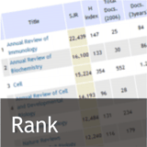
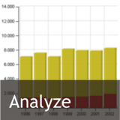
SCImago Journal Rank
Alternative to Impact Factor
Open Access
Developed by SCImago lab, based on Scopus data
Includes 19 400 journals from 1996
Engine similar to Google PageRank™ algorithm
Regarded as a “prestige metric”
Notes:
For a long time Journal Citation Reports were the only way to determine journals ranking. However, Scopus (another very large indexing source) have developed similar indicators to rank journals based on citations.
SCImago Journal Rank (SJR) is a prestige metric. Calculations for this indicator are based on the principle that citations from high profile journals weigh more than journals with low impact.
To find this indicator, go to:
Library homepage > Search > E-databases > Scopus > Click on Sources in the top horisontal menu bar.

Slide 29
About SJR
The SJR indicator assigns different values to citations depending on the importance of the journals where they come from. This way, citations coming from highly important journals will be more valuable and hence will provide more prestige to the journals receiving them.
Notes:
For a long time Journal Citation Reports were the only way to determine journals ranking. However, Scopus (another very large indexing source) have developed similar indicators to rank journals based on citations.
SCImago Journal Rank (SJR) is a prestige metric. Calculations for this indicator are based on the principle that citations from high profile journals weigh more than journals with low impact.
To find this indicator, go to:
Library homepage > Search > E-databases > Scopus > Click on Sources in the top horisontal menu bar.

Slide 30
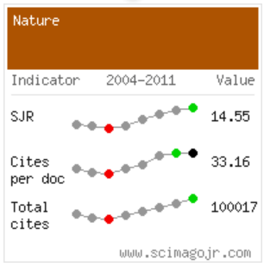
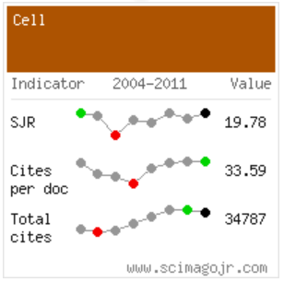
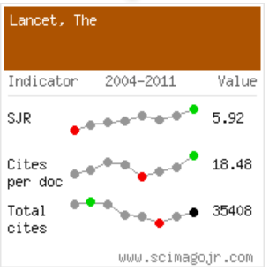
Find SJR
To find the SJR indicator, go to: Library homepage (library.sun.ac.za) > Search > E-databases > Scopus > Click on Sources in the top horisontal menu bar
Go directly to: http://www.scimagojr.com/ >

Slide 31
SNIP
SNIP = Source-Normalized Impact per Paper
Created by Prof Henk Moed at University of Leiden
Citations are weighted based on the number of citations in a subject field (If there are fewer total citations in a research field, then citations are worth more in that field)
Aims to allow direct comparison of sources in different subject fields
Corrects the differences between subject fields
E.g. Mathematics, Engineering and Social Sciences tend to have lower values than titles in Life Sciences
Notes:
About SNIP = Source-Normalized Impact per Paper
Created by Professor Henk Moed at CTWS, University of Leiden, Source-Normalized Impact per Paper (SNIP) measures contextual citation impact by weighting citations based on the total number of citations in a subject field.
The impact of a single citation is given higher value in subject areas where citations are less likely, and vice versa.
It is defined as the ratio of a journal’s citation count per paper and the citation potential in its subject field. It aims to allow direct comparison of sources in different subject fields.
Citation potential is shown to vary not only between journal subject categories – groupings of journals sharing a research field – or disciplines (e.g., journals in Mathematics, Engineering and Social Sciences tend to have lower values than titles in Life Sciences), but also between journals within the same subject category. For instance, basic journals tend to show higher citation potentials than applied or clinical journals, and journals covering emerging topics higher than periodicals in classical subjects or more general journals.
SNIP corrects for such differences. Its strengths and limitations are open to critical debate. All empirical results are derived from the Scopus abstract and indexing database.
NIP values are updated twice a year, providing an up-to-date view of the research landscape.

Slide 32
Find SNIP
To find the SNIP indicator, go to: Library homepage (library.sun.ac.za) > Search > E-databases > Scopus > Click on Sources in the top horisontal menu bar.
In the search box to the right, type the title of the journal e.g. African Journal of AIDS Research

Slide 33
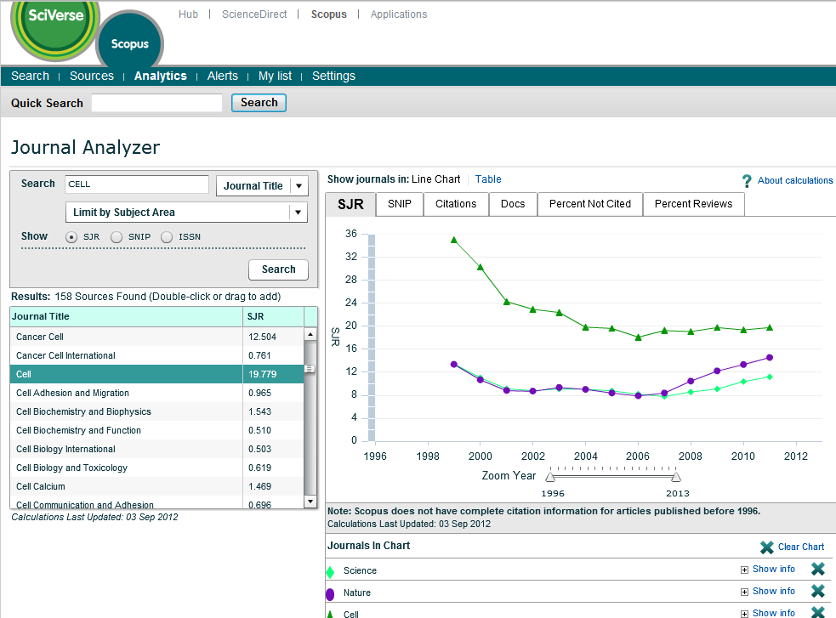
Citation Analyser
Notes:
Scopus provides a visualisation tool for comparing different journals with each other
Find it: Library homepage (www.library.sun.ac.za) > e-Databases > Scopus > Analytics
On the left a search box is provided where the journal title can be entered.
The results are displayed in a Results Box below.
Drag the retrieved title to the empty box on the right to display the SJR or SNIP values over time

Slide 34
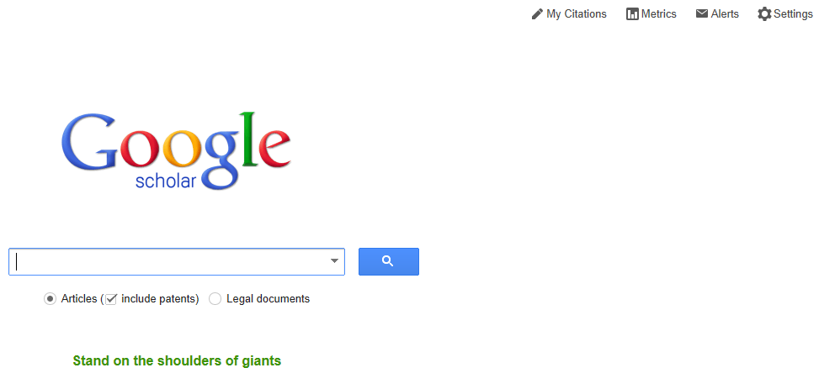
Google Metrics
Google Scholar ranks scholarly journals based on h5-index
Based on the hirch-index used to express individual researcher’s impact
A journal with an h5-index of 100 means that 100 of its articles have been cited 100 times over 5 years
Notes:
Scholar Metrics only include publications with at least a hundred articles in the last five years.
Overview
Scholar Metrics summarize recent citations to many publications, to help authors as they consider where to publish their new research.
To get started, you can browse the top 100 publications in several languages, ordered by their five-year h-index and h-median metrics. To see which articles in a publication were cited the most and who cited them, click on its h-index number to view the articles as well as the citations underlying the metrics.
You can also explore publications in research areas of your interest. To browse publications in a broad area of research, select one of the areas in the left column. For example: Engineering & Computer Science or Health & Medical Sciences.
To explore specific research areas, select one of the broad areas, click on the "Subcategories" link and then select one of the options. For example: Databases & Information Systems or Development Economics.
Browsing by research area is, as yet, available only for English publications. You can, of course, search for specific publications in all languages by words in their titles.
Metrics
Scholar Metrics currently cover articles published between 2007 and 2011, both inclusive. The metrics are based on citations from all articles that were indexed in Google Scholar as of November 15th, 2012. This also includes citations from articles that are not themselves covered by Scholar Metrics.
The h-index of a publication is the largest number h such that at least h articles in that publication were cited at least h times each. For example, a publication with five articles cited by, respectively, 17, 9, 6, 3, and 2, has the h-index of 3.
The h-core of a publication is a set of top cited h articles from the publication. These are the articles that the h-index is based on. For example, the publication above has the h-core with three articles, those cited by 17, 9, and 6.
The h-median of a publication is the median of the citation counts in its h-core. For example, the h-median of the publication above is 9. The h-median is a measure of the distribution of citations to the articles in the h-core.
Finally, the h5-index, h5-core, and h5-median of a publication are, respectively, the h-index, h-core, and h-median of only those of its articles that were published in the last five complete calendar years.

Slide 35
Exercise
Provide the SJR for:
American Journal of Sports Medicine
Sports Medicine
Provide the SNIP for:
South African Journal of Geology
Use Google Scholar Metric and provide the respective h5-index for a) Cell b) Lancet

Slide 36
Choosing Open Access
Movement to harness Internet capabilities
Berlin Declaration on Open Access to Knowledge in the Sciences and Humanities
Objective is to make research material easily accessible to ALL
Traditional journals’ business model = subscriptions
Open Access business model = author/research funds
Notes:
Movement to harness Internet capabilities
The Open Access movement has been around for some time, but it really got momentum in 2003 when scientists got together at the Max Planck Institute to sign an agreement which was aimed at implementing a new system whereby the internet would be harnessed to make scientific information more freely accessible.
Berlin Declaration on Open Access to Knowledge in the Sciences and Humanities
The agreement that was signed, is known as the Berlin Declaration on Open Access to Knowledge in the Sciences and Humanities. Now, ten years later, it has more than 400 signatories among whom are Harvard University, Cern and the Chinese Academy of Science. In 2010, SU became the first institution in Africa to sign the Declaration.
Objective is to make research material easily accessible to ALL
One of the important objectives of Open Access is to make research material easily accessible to poorer countries with limited research budgets. Ultimately when this happens more research can be done to find solutions for some of the world’s issues - illnesses, poverty etc.
Business model
To explain how it works in very simple terms, one should compare it with the traditional publication system. All the journals we have referred to earlier, such as Nature, Cell, Science, Lancet use the traditional publication model. These journals rely on the business model that the publishing expenses are paid by the end-user. Mostly this is through library subsciptions. Because subscriptions are very expensive, it means that only rich institutions have access to research and sometimes it means that we don’t have access to our own research – or in fact we have to pay to use it.
With Open Access the author pays the publishing cost. The idea is of course not for the author himself/herself to pay but to use research funds.

Slide 37
Green and Gold
Green Open Access = self archiving
Gold Open Access = open access journal
Creative Commons licenses -
authors grant a non-exclusive license to the publisher to distribute their work
CC-BY unrestricted reuse of content, subject to attribution
Notes:
Two predominant models have emerged within the Open Access movement
Green OA = self archiving
The Green OA route means that the author publishes in any journal and archives a copy (post print) in the institution’s repository
Gold OA = Open Access journal
The Gold OA route means the author publishes his/her research in an Open Access journal where it will be available immediately along with all other articles on the publisher's website
Creative Commons License
To fully realise the potential of open access, Creative Commons licenses have emerged as an effective legal instrument to minimize restrictions to research.
Instead of transferring rights exclusively to publishers (the approach usually followed in subscription publishing), authors grant a non-exclusive license to the publisher to distribute the work.
All users and readers are granted rights to re-use the work.
The most liberal Creative Commons license is CC-BY, which allows for unrestricted reuse of content, subject only to the requirement that the source work is appropriately attributed.

Slide 38
Benefits of Open Access
Increased visibility
Increased usage
Increased impact
Access to those who cannot afford
Centrally & safely archived
Reviewed by all …

Slide 39
OA at Stellenbosch
http://library.sun.ac.za/English/services/az/oa/Pages/default.aspx
Or, follow the path: Library homepage (library.sun.ac.za) > Services> Open Access
Notes:
Stellenbosch University is a enthusiastic advocate for Open Access.
We have therefore developed a comprehensive set of webpages about the various aspects of Open Access such as:
What is Open Access
Stellenbosch University open access initiatives
Open Access Fund
SUNScholar, SUNJournal, SUNConferences
Useful links & news on Open Access
Contact information
Supplementary workshops
This workshop can only give a brief overview of Open Access. For more detail you should attend the workshop
“How can Open Access increase your citation rate” which is an hour long presentation, presented regularly through-out the year
Next presented on 22 Aug 2013. Bookings can be made on the Library Training Calendar.

Slide 40
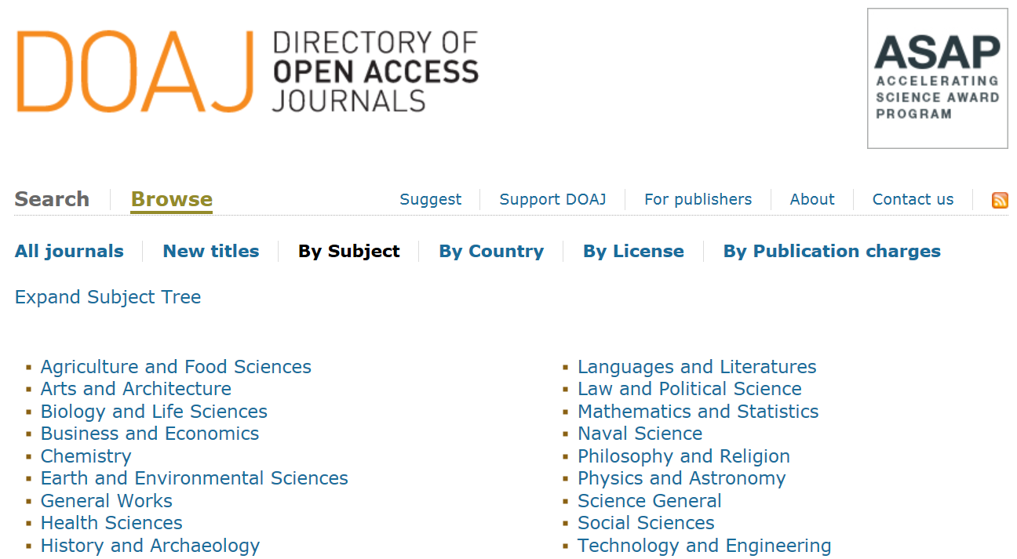
DOAJ
www.doaj.org
Notes:
How to identify Open Access Journals?
DOAJ is a database of open access journals covering all scientific and scholarly subjects.
Primarily used to identify open access journal titles (and forty percent of them are searchable at the article level)
Journals can be browsed by title or by broad subject area. To be included in the DOAJ, journals must use a funding model that does not charge readers or their institutions for access and must exercise peer-review or editorial quality control.
DOAJ is therefore regarded as a gatekeeper – ensures that journals are legitimate in terms of business model and provision of access to journal articles.

Slide 41
Exercise
Provide the name of an Open Access Journal in the subject fields of:
mathematics
statistics
Notes:
For a long time Journal Citation Reports were the only way to determine journals ranking. However, Scopus (another very large indexing source) have developed similar indicators to rank journals based on citations.
SCImago Journal Rank (SJR) is a prestige metric. Calculations for this indicator are based on the principle that citations from high profile journals weigh more than journals with low impact.
To find this indicator, go to:
Library homepage > Search > E-databases > Scopus > Click on Sources in the top horisontal menu bar.

Slide 42
Open Access Fund
http://library.sun.ac.za/English/services/az/ oa/Pages/su-oafund.aspx
Fund to support SU researchers
Institutional memberships with Open Access publishers
Subsidise author fees of legitimate OA journals
Subsidise author fees for publishing in hybrid journals
All co-authors to be affiliated to SU
Journals should be accredited / approved list of DHET
Online form
Notes:
An Open Access Fund has been established to support Stellenbosch University (SU) researchers publishing in open access journals with funding.
The purpose of the fund: To subside author fees for publishing in open access journals To subsidise author fees for publishing in hybrid journals Taking up institutional memberships with Open Access publishers such as BioMed Central (BMC) and Public Library of Science (PLoS). Institutional membership endorses open access publishing and allows for the subsidising of author fees of Stellenbosch University researchers publishing in these journals.
Important criteria:
All co-authors to be affiliated to SU
Journals should be accredited / approved list of DHET
Form:
In order to apply for funding from the Fund, the Open Access Fund Application Form must be completed.

Slide 43
Self archive
Why self archive your research article
Institutional repository (SUNScholar)
Steps to follow for adding articles to SUNScholar
http://scholar.sun.ac.za/
Notes:
Why self archive
To ensure that you and readers will have on-going and easy access to your research article, it is advised that you archive it in the University’s Institutional repository, SUNScholar.
Find SUNScholar:
Find SUNScholar on the Library’s website: http://library.sun.ac.za > Search > SUNScholar
Steps to upload your article to SUNScholar
Register as a contributor to the system
You will receive a confirmation e-mail
On receipt of the e-mail, contact SUNScholar in order to determine the collections for which you are registered
Sign-in on the right navigation bar using your campus authentication
Select My Account
Select Submissions
Complete the steps as presented on screen

Slide 44
References
Badenhorst, C. 2010. Productive writing: Becoming a prolific academic writer. Pretoria: Van Schaik.
Becker, L. & Denicolo, P. 2012. Publishing journal articles. London: Sage.
Belcher, W.L. 2009. Writing your journal article in 12 weeks: A guide to academic publishing success. London: Sage.
Brown, T. Journal quality metrics: Everything you wanted to know but were afraid to ask!. Monash University [Online]. Available:
http://www.monash.edu.au/campuses/peninsula/assets/images/pdfs/journal-quality-metrics.pdf . [2013, 21 May].
Choudhury, S., & Chakraborty, U.S. 2010. The impact of impact factors in measuring research quality. Assam University Journal of Science and Technology, 5(2), 50-52.
Gevers, W. The concept of ‘The (scientific/scholarly) literature’. Academy of Science of South Africa: Online Scientific Writing, Module 1. [Online]. Available: http://www.assaf.co.za/osc/introduction. [2013, 19 May].
Harzing, A. 2011.The publish or perish book, part 3: doing bibliometric research with Google Scholar. Melbourne:Tarma software research.
Leydesdorff, L. 2008. Caveats for the use of citation indicators in research and journal evaluations. Journal of the American Society for Information Science and Technology, 59(2), 278-287.

